Slide 1

CODE REFACTORING AND BUG FIXING REPORT
ON
NOTE TAKING APPLICATION

Slide 2
About me
I am Akanksha Wagh , I have completed my Bachelor of Science in the year 2023 . Presently I am pursing my Data Science Course at Innomatics Research Labs.
I am a Fresher
I am enthusiastic about data science , especially considering how to quickly technology is changing the profession. My aim is to provide accurate information and insightss to help user understand and work with data effectively .
Linkedin : https://www.linkedin.com/in/akankshawagh/
Github : https://github.com/AkankshaWagh123

Slide 3
Agenda of Report :
Objective of the project
Identification of the Bugs
Modifing Final Code
Final Outcome
Conclusion
Technically Implemented :
Python : Backend Scripting Language
Flask : Lightweight Web Framework

Slide 4
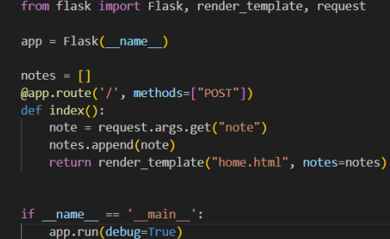
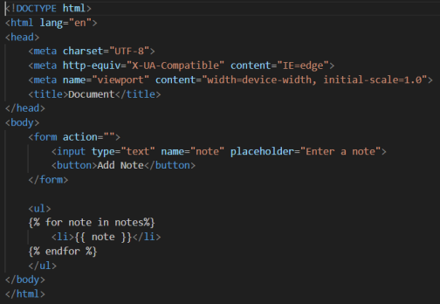
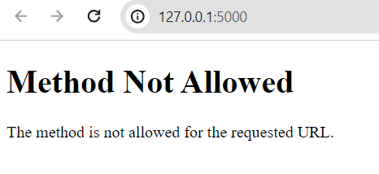
BUG FINDING ON THE APPLICATION SERVER :
CODE
OUTPUT

Slide 5
BUG DETECTION:
CODE
NOTE:
We have to use the "GET" method instead of the "POST" technique as the former isn't enabling us to render the template.

Slide 6
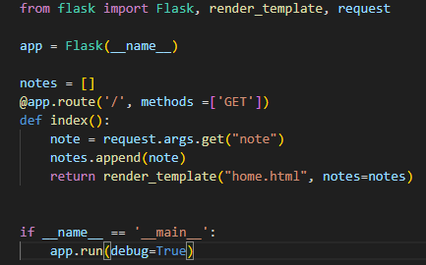
FIXING BUGS :
CODE

Slide 7
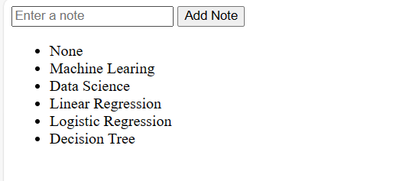
FIXING BUGS :
OUTPUT
NOTE:
Now that the bug has been addressed, it is functioning properly.

Slide 8

THANK YOU

